Slide 1
Transmission
Control Protocol
TCP/IP Protocol Suite

Slide 2
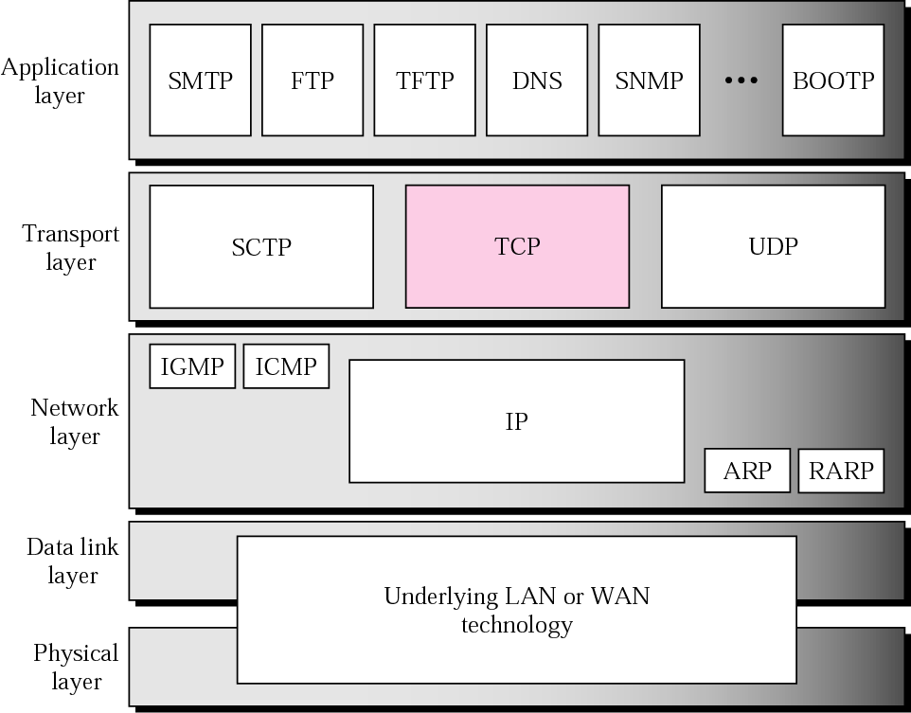
Figure TCP/IP protocol suite
TCP/IP Protocol Suite

Slide 3
TCP is the major protocol of Transport Layer.
TCP is Connection Oriented Communication Protocol of the Transport Layer
Support Graceful Opening of Connection bt/w Client & Server (called 3-Way Handshake for Connection Established)
Dialog with acks,retransmission
Graceful Closure of Connection bt/w client & server ( called as 3-Way/4-Way Handshake for Connection termination).
Support Packet Sequencing & Ack Sequencing.
TCP is a reliable protocol
TCP is relatively a slower protocol
TCP/IP Protocol Suite

Slide 4
TCP SERVICES
Process-to-Process /Host-to-Host Communication
Flow Control
Error Control
Retransmission
Stream Delivery Service/bytes-stream communication
Full-Duplex Communication
Connection-Oriented Service
Reliable Service
Numbering System/Packet Sequencing
Congestion Control
Encapsulation and Decapsulation
Queuing
Multiplexing and Demultiplexing
TCP/IP Protocol Suite

Slide 5
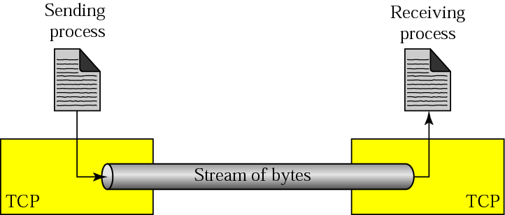
Figure Stream delivery
TCP/IP Protocol Suite

Slide 6
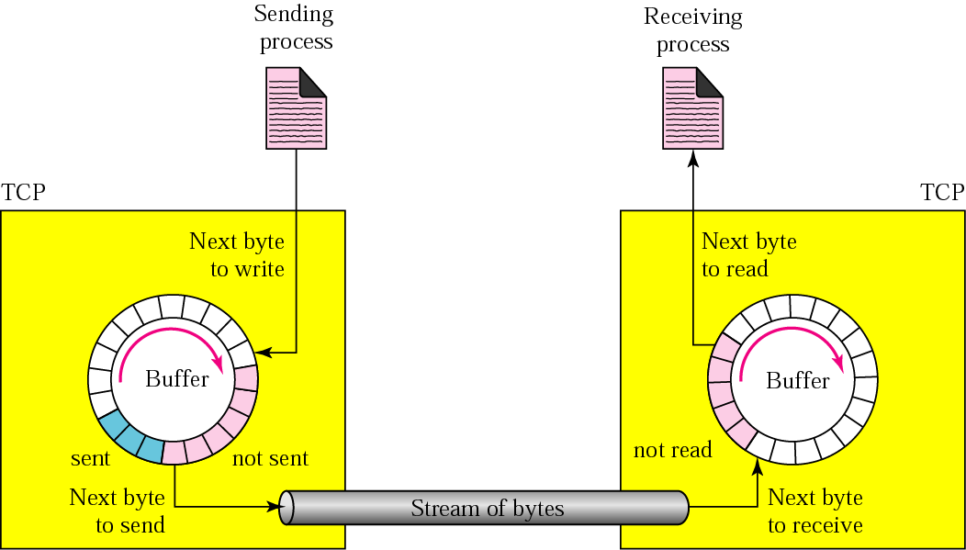
Figure Sending and receiving buffers
TCP/IP Protocol Suite

Slide 7
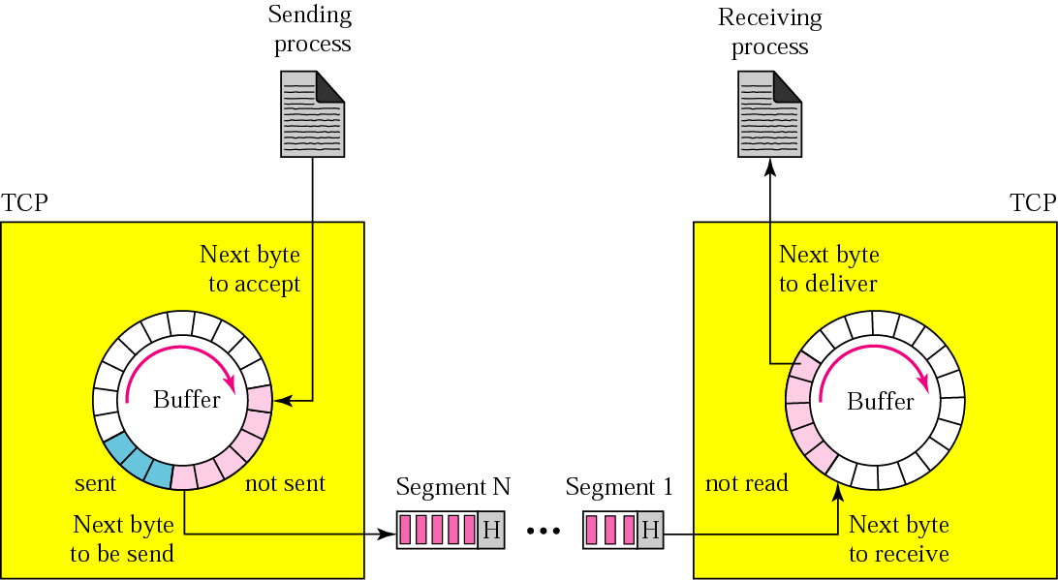
Figure TCP segments
TCP/IP Protocol Suite

Slide 8
The bytes of data being transferred in each connection are numbered by TCP. The numbering starts with a randomly generated number.
The value in the sequence number field of a segment defines the number of the first data byte contained in that segment.
The value of the acknowledgment field in a segment defines the number of the next byte a party expects to receive.
The acknowledgment number is cumulative.
TCP/IP Protocol Suite

Slide 9
Example
Suppose a TCP connection is transferring a file of 5000 bytes. The first byte is numbered 10001. What are the sequence numbers for each segment if data is sent in five segments, each carrying 1000 bytes?
Solution
The following shows the sequence number for each segment:
Segment 1 ➡ Sequence Number: 10,001 (range: 10,001 to 11,000)
Segment 2 ➡ Sequence Number: 11,001 (range: 11,001 to 12,000)
Segment 3 ➡ Sequence Number: 12,001 (range: 12,001 to 13,000)
Segment 4 ➡ Sequence Number: 13,001 (range: 13,001 to 14,000)
Segment 5 ➡ Sequence Number: 14,001 (range: 14,001 to 15,000)
TCP/IP Protocol Suite

Slide 10
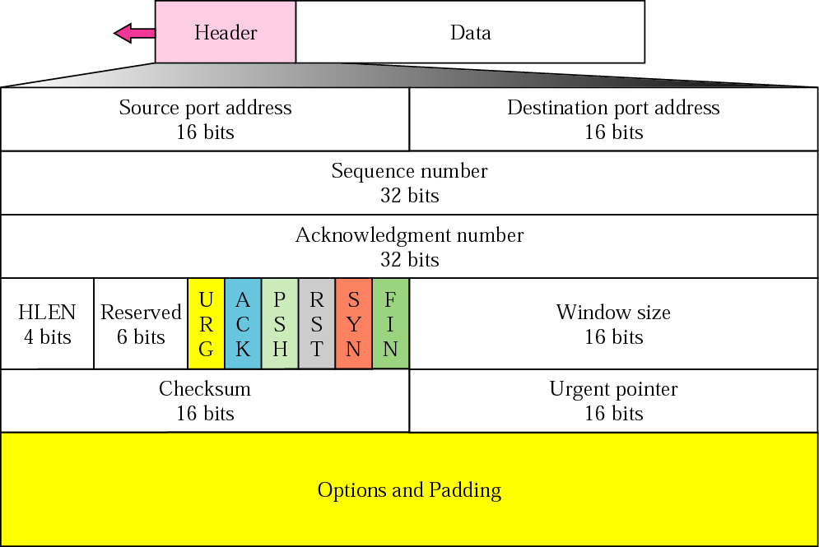
A packet in TCP is called a segment
SEGMENT
Figure TCP segment format
TCP/IP Protocol Suite

Slide 11
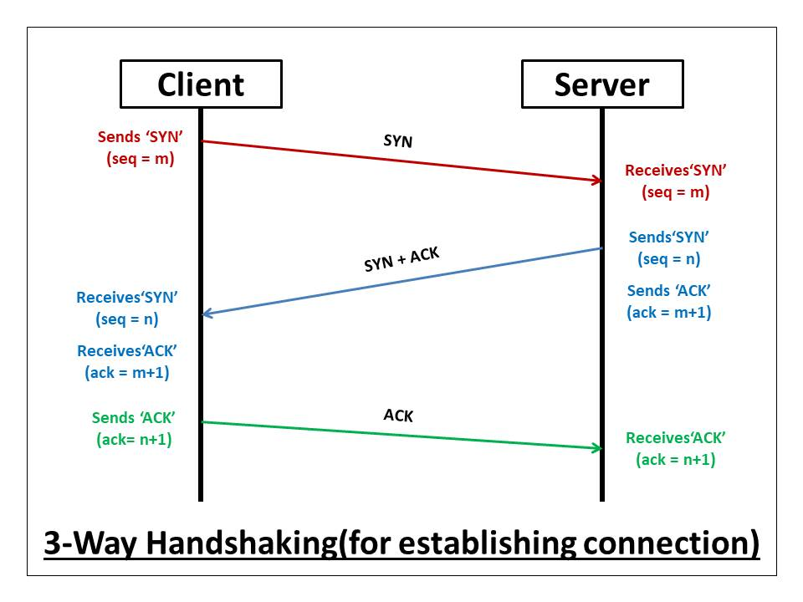
TCP/IP Protocol Suite

Slide 12
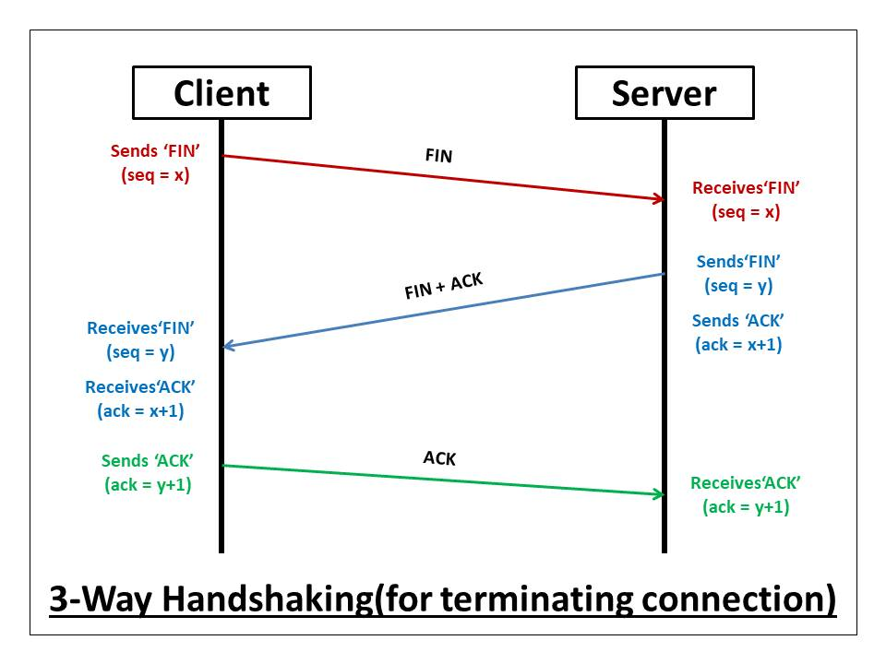
TCP/IP Protocol Suite

Slide 13
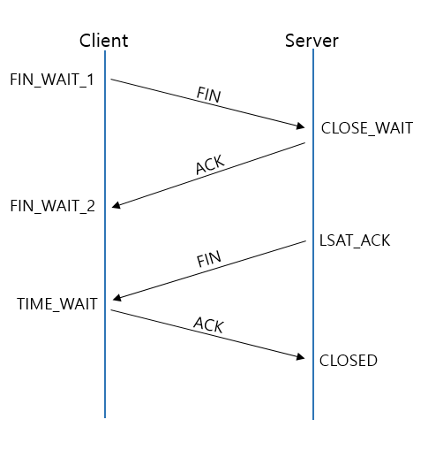
TCP/IP Protocol Suite

Slide 14
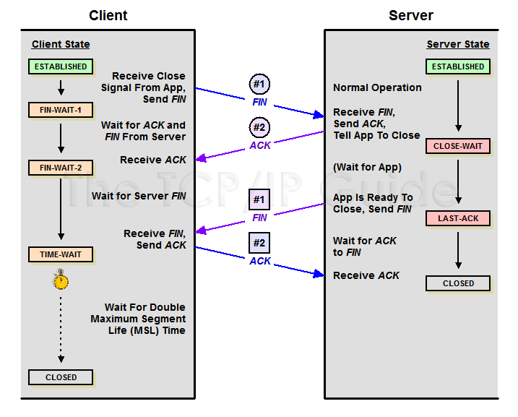
TCP/IP Protocol Suite

Slide 15

Figure Encapsulation and decapsulation
TCP/IP Protocol Suite

Slide 16
A TCP CONNECTION
TCP is connection-oriented.
A connection-oriented transport protocol establishes a virtual path between the source and destination.
All of the segments belonging to a message are then sent over this virtual path.
A connection-oriented transmission requires three phases:
connection establishment,
data transfer,
and connection termination.
TCP/IP Protocol Suite

Slide 17
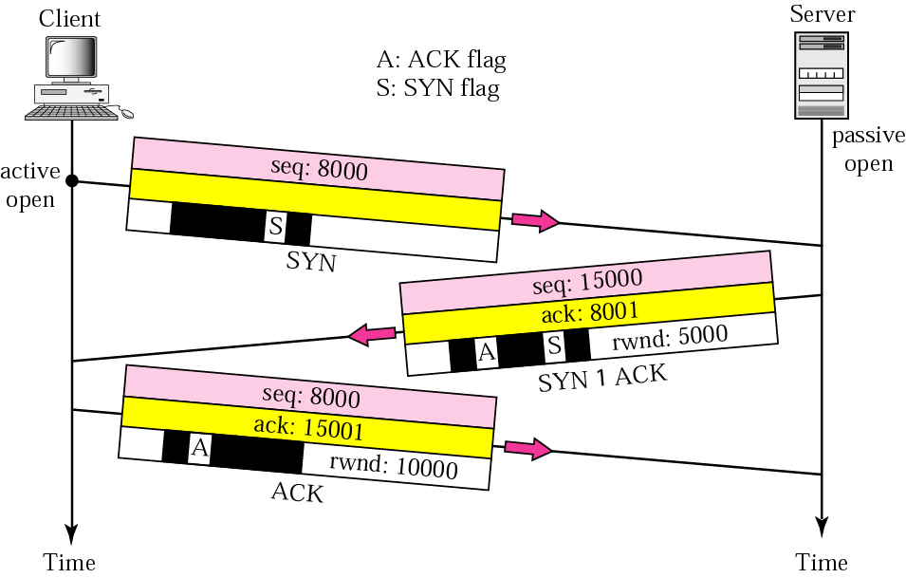
Figure Connection establishment using three-way handshaking
TCP/IP Protocol Suite

Slide 18
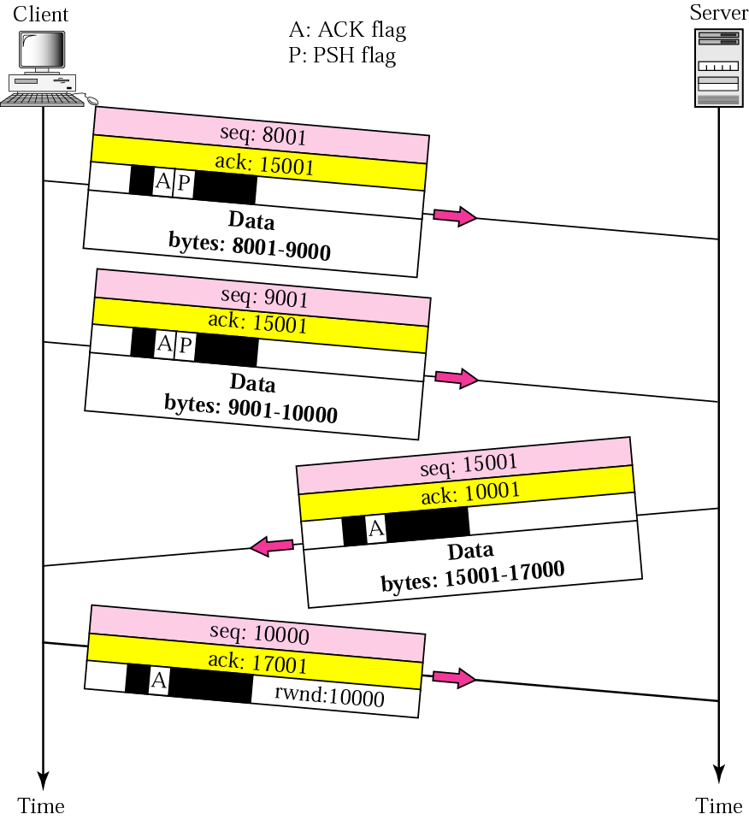
Figure Data transfer
TCP/IP Protocol Suite

Slide 19
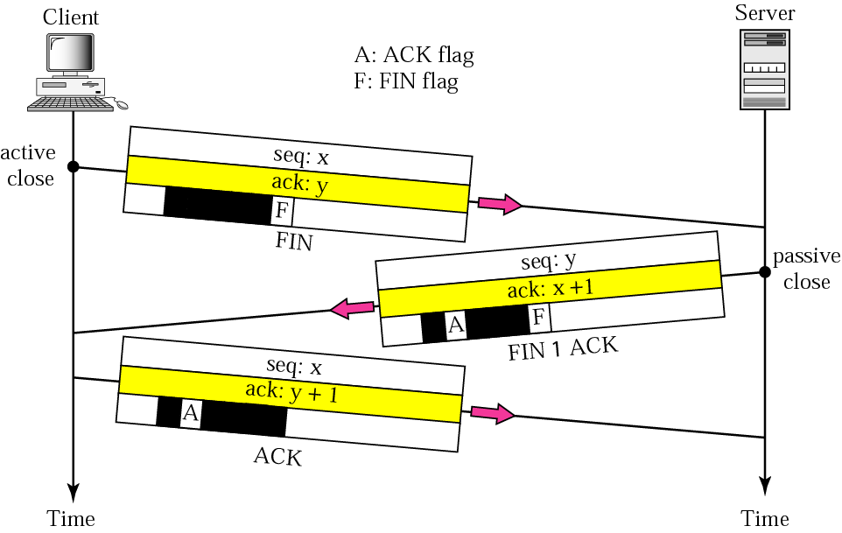
Figure Connection termination using three-way handshaking
TCP/IP Protocol Suite

Slide 20
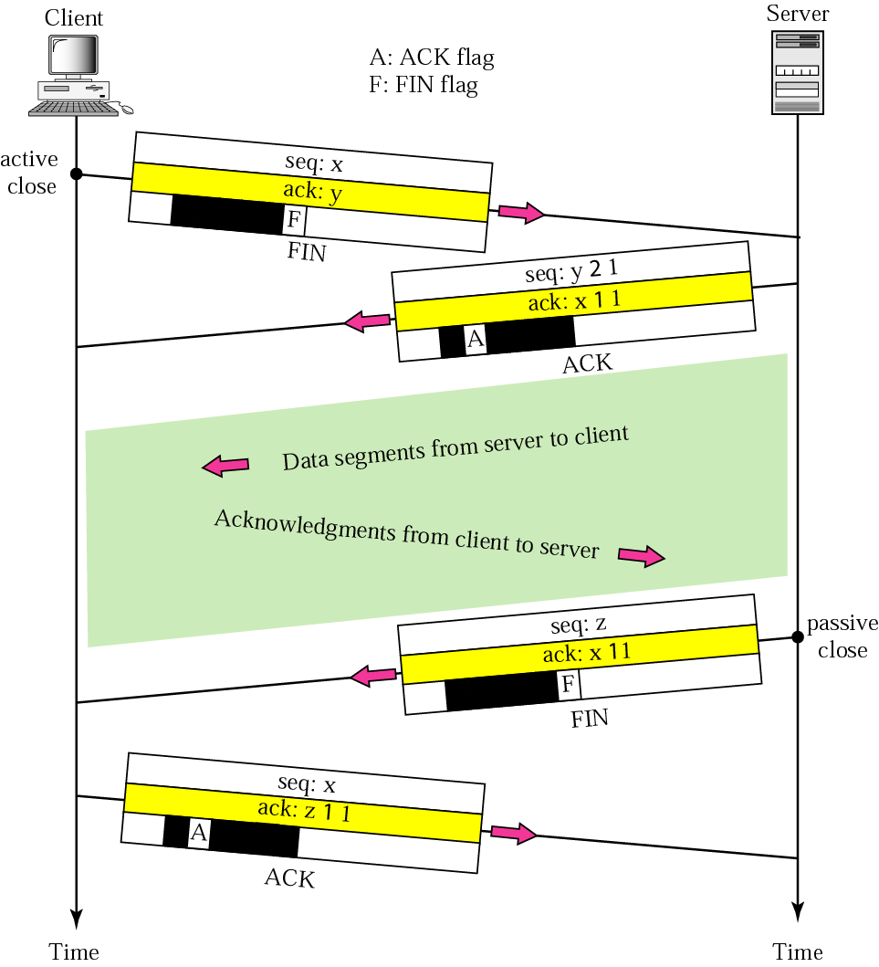
Figure Half-close
TCP/IP Protocol Suite

Slide 21
A SYN segment cannot carry data, but it consumes one sequence number.
A SYN + ACK segment cannot carry data, but does consume one
sequence number.
An ACK segment, if carrying no data, consumes no sequence number.
The FIN segment consumes one sequence number if it does not carry data.
The FIN + ACK segment consumes one sequence number if it does not carry data.
TCP/IP Protocol Suite

Slide 22
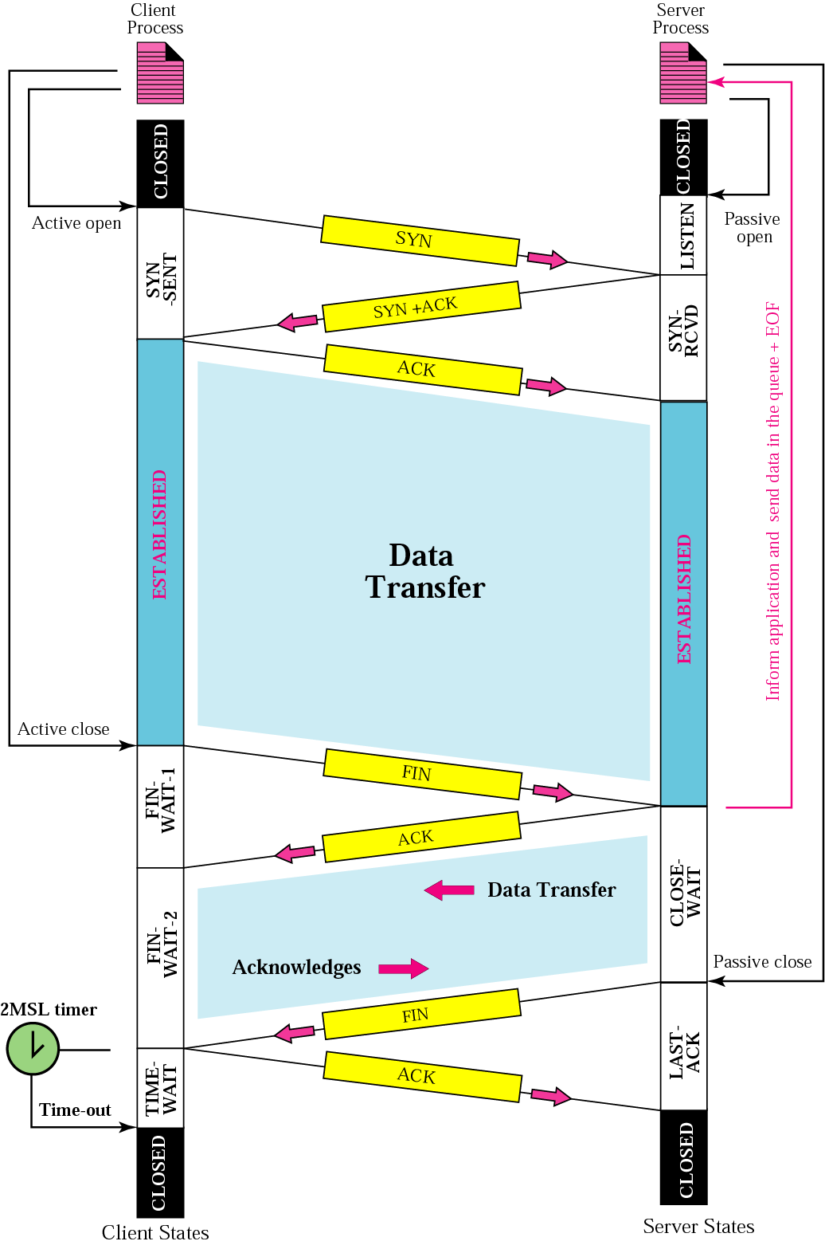
Figure Common scenario
TCP/IP Protocol Suite

Slide 23
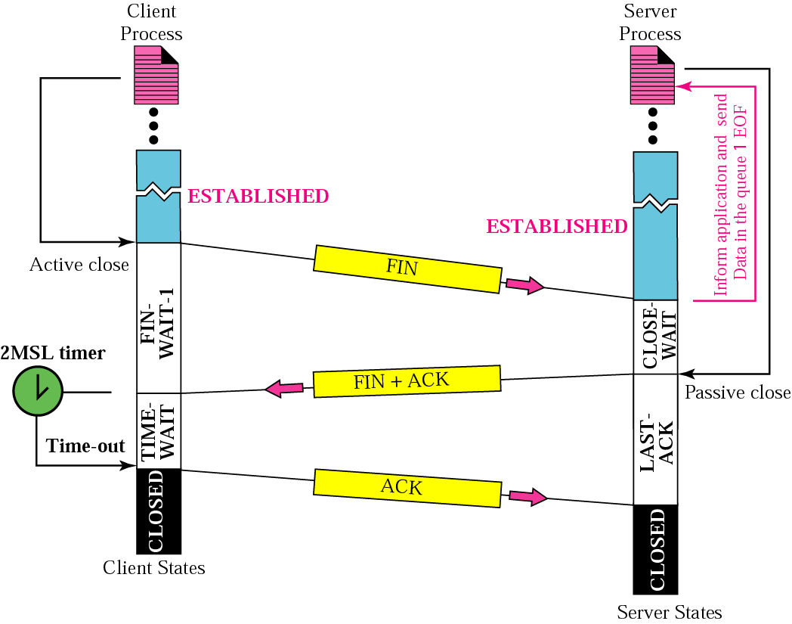
Figure Three-way handshake
TCP/IP Protocol Suite

Slide 24
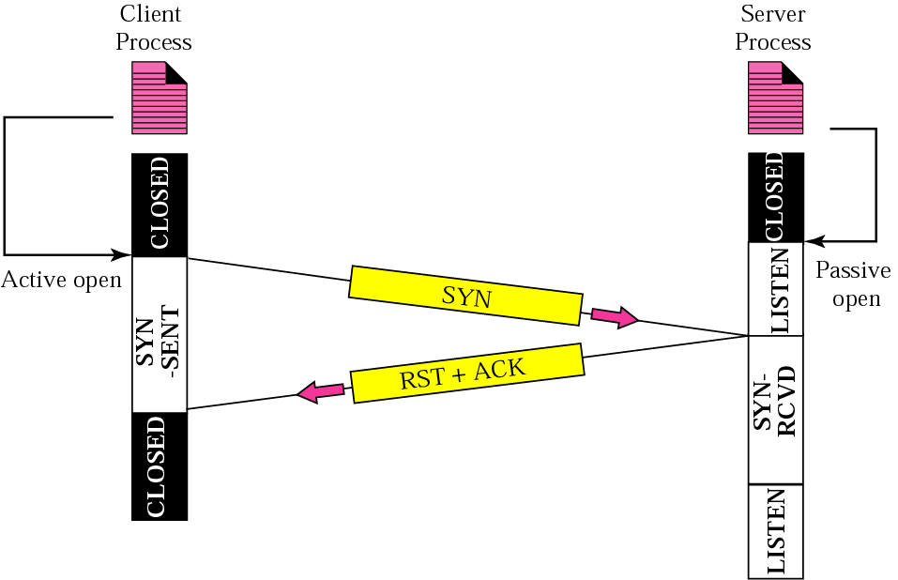
Figure Denying a connection
TCP/IP Protocol Suite

Slide 25
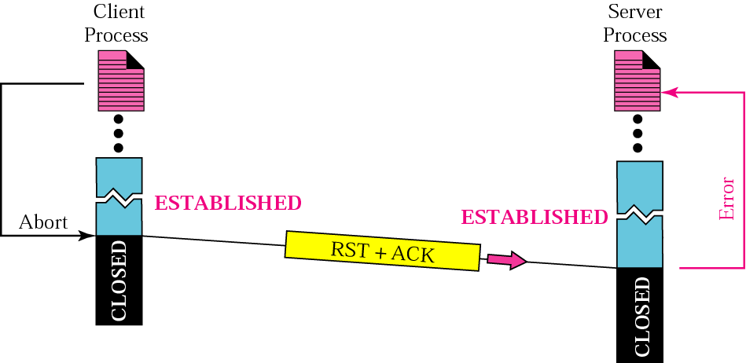
Figure Aborting a connection
TCP/IP Protocol Suite

Slide 26
FLOW CONTROL
Flow control regulates the amount of data a source can send before receiving an acknowledgment from the destination.
TCP defines a window that is imposed on the buffer of data delivered from the application program.
TCP/IP Protocol Suite

Slide 27

Note:
A sliding window is used to make transmission more efficient as well as to control the flow of data so that the destination does not become overwhelmed with data.
TCP’s sliding windows are byte oriented.
TCP/IP Protocol Suite

Slide 28
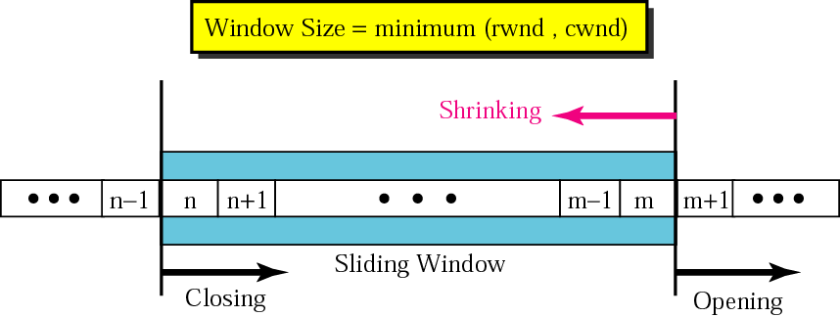
Figure Sliding window
TCP/IP Protocol Suite

Slide 29
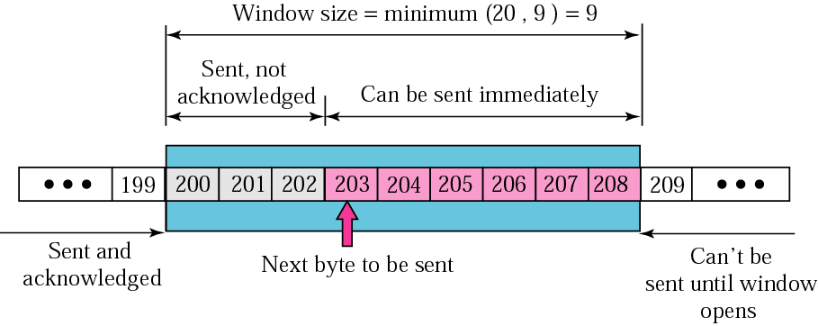
Figure
TCP/IP Protocol Suite

Slide 30
ERROR CONTROL
TCP provides reliability using error control, which detects corrupted, lost, out-of-order, and duplicated segments. Error control in TCP is achieved through the use of the checksum, acknowledgment, and time-out.
TCP/IP Protocol Suite

Slide 31
Note:
Data may arrive out of order and be temporarily stored by the receiving TCP, but TCP guarantees that no out-of-order segment is delivered to the process.
TCP/IP Protocol Suite

Slide 32
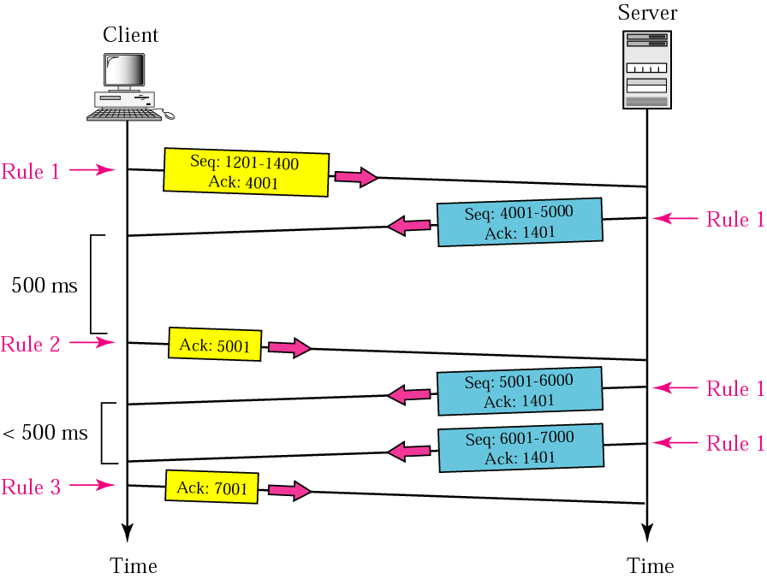
Figure 12.25 Normal operation
TCP/IP Protocol Suite

Slide 33
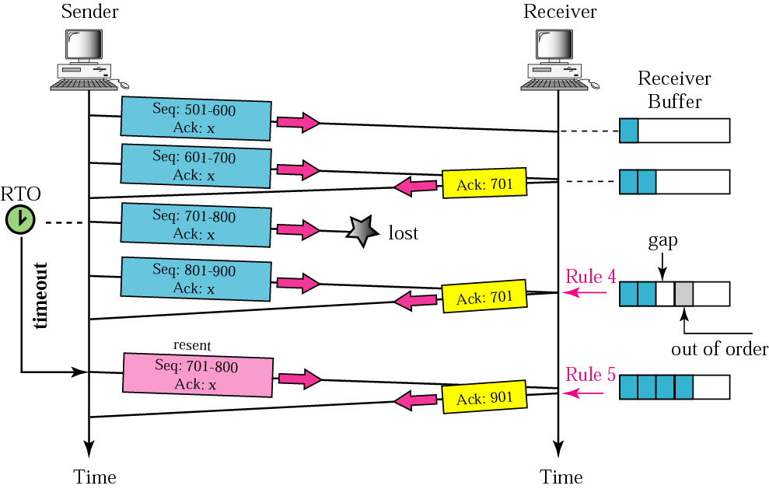
Figure 12.26 Lost segment
TCP/IP Protocol Suite

Slide 34
Note:
The receiver TCP delivers only ordered data to the process.
TCP/IP Protocol Suite

Slide 35
CONGESTION CONTROL
Congestion control refers to the mechanisms and techniques to keep the load below the capacity.
TCP/IP Protocol Suite

Slide 36
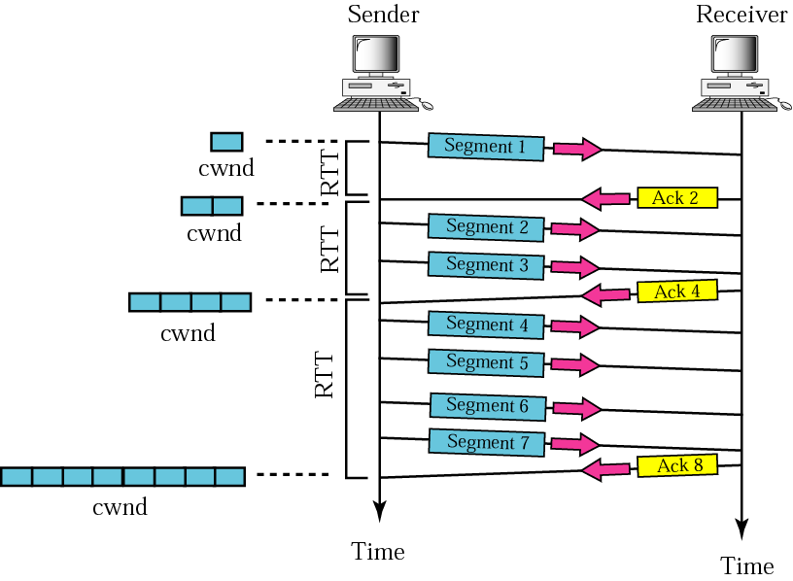
Figure Slow start, exponential increase
TCP/IP Protocol Suite

Slide 37
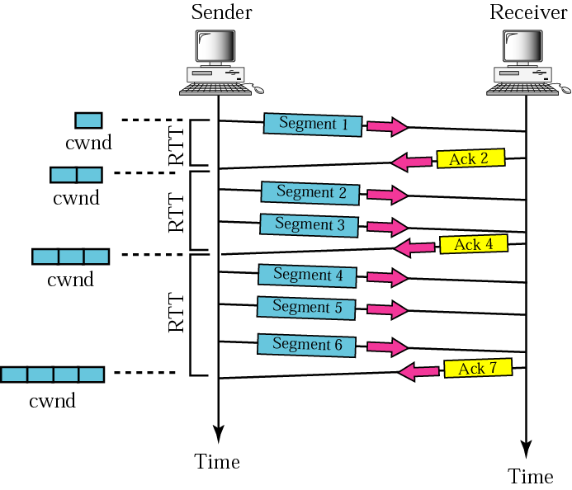
Figure Congestion avoidance, additive increase
TCP/IP Protocol Suite

Slide 38
TCP TIMERS
To perform its operation smoothly, most TCP implementations use at least four timers. Timers used by TCP to avoid excessive delays during communication are called as TCP Timers.
Retransmission Timer
Persistence Timer
Keepalive Timer
TIME-WAIT Timer
TCP/IP Protocol Suite

Slide 39
Time Out Timer-
TCP uses a time out timer for retransmission of lost segments.
Sender starts a time out timer after transmitting a TCP segment to the receiver.
If sender receives an acknowledgement before the timer goes off, it stops the timer.
If sender does not receives any acknowledgement and the timer goes off, then TCP Retransmission occurs.
Sender retransmits the same segment and resets the timer.
The value of time out timer is dynamic and changes with the amount of traffic in the network.
Time out timer is also called as Retransmission Timer.
TCP/IP Protocol Suite

Slide 40
Time Wait Timer-
TCP uses a time wait timer during connection termination.
Sender starts the time wait timer after sending the ACK for the second FIN segment.
It allows to resend the final acknowledgement if it gets lost.
It prevents the just closed port from reopening again quickly to some other application.
It ensures that all the segments heading towards the just closed port are discarded.
The value of time wait timer is usually set to twice the lifetime of a TCP segment.
TCP/IP Protocol Suite

Slide 41
Keep Alive Timer-
TCP uses a keep alive timer to prevent long idle TCP connections.
Each time server hears from the client, it resets the keep alive timer to 2 hours.
If server does not hear from the client for 2 hours, it sends 10 probe segments to the client.
These probe segments are sent at a gap of 75 seconds.
If server receives no response after sending 10 probe segments, it assumes that the client is down.
Then, server terminates the connection automatically.
TCP/IP Protocol Suite

Slide 42
Persistent Timer-
TCP uses a persistent timer to deal with a zero-widow-size deadlock situation.
It keeps the window size information flowing even if the other end closes its receiver window.
Sender starts the persistent timer on receiving an ACK from the receiver with a zero window size.
When persistent timer goes off, sender sends a special segment to the receiver.
This special segment is called as probe segment and contains only 1 byte of new data.
Response sent by the receiver to the probe segment gives the updated window size.
If the updated window size is non-zero, it means data can be sent now.
If the updated window size is still zero, the persistent timer is set again and the cycle repeats.
TCP/IP Protocol Suite

Slide 43
OPTIONS
The TCP header can have up to 40 bytes of optional information. Options convey additional information to the destination or align other options.
TCP/IP Protocol Suite

Slide 44
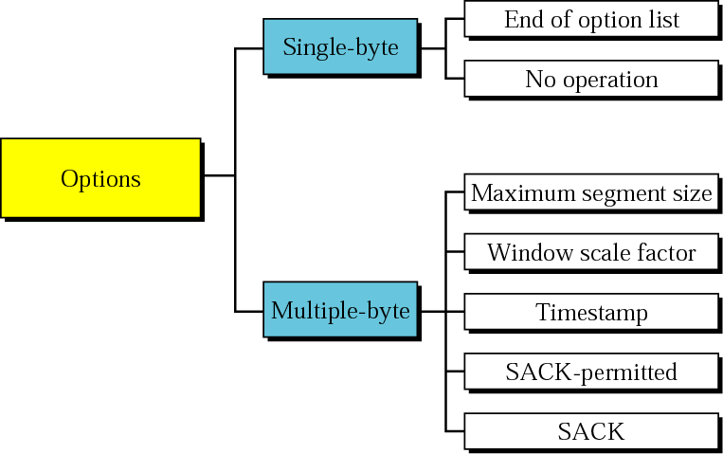
Figure Options
TCP/IP Protocol Suite

Slide 45
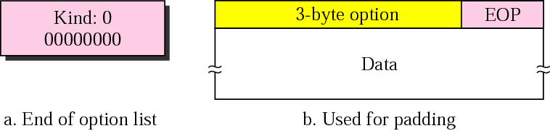
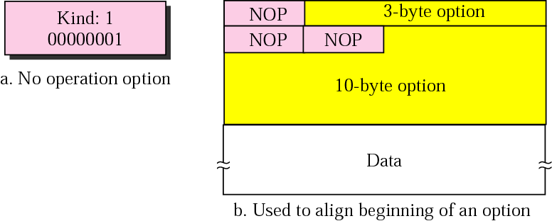
Figure End-of-option option
Figure No-operation option
TCP/IP Protocol Suite

Slide 46
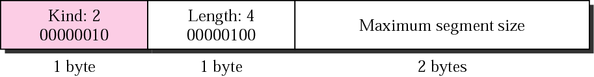
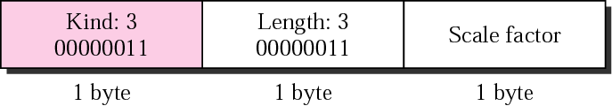
Figure Maximum-segment-size option
The value of MSS is determined during connection establishment and does not change during the connection.
Figure Window-scale-factor option
The value of the window scale factor can be determined only during connection establishment; it does not change during the connection.
TCP/IP Protocol Suite

Slide 47
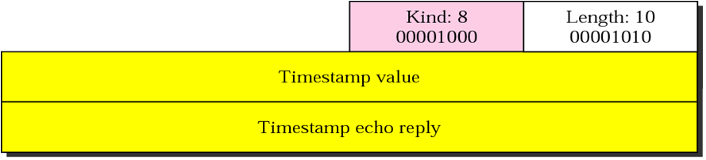
Figure Timestamp option
One application of the timestamp option is the calculation of round trip time (RTT).
TCP/IP Protocol Suite

Slide 48
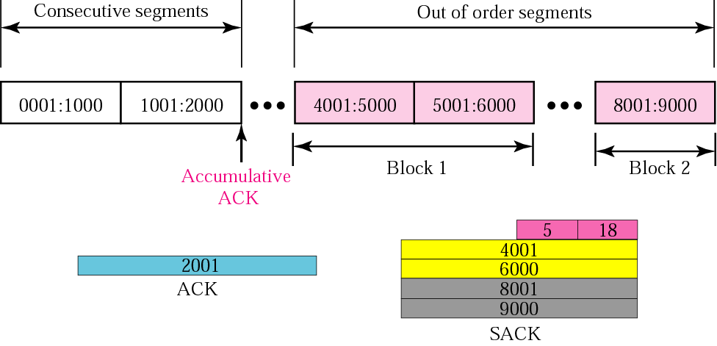
Figure
TCP/IP Protocol Suite

Slide 49
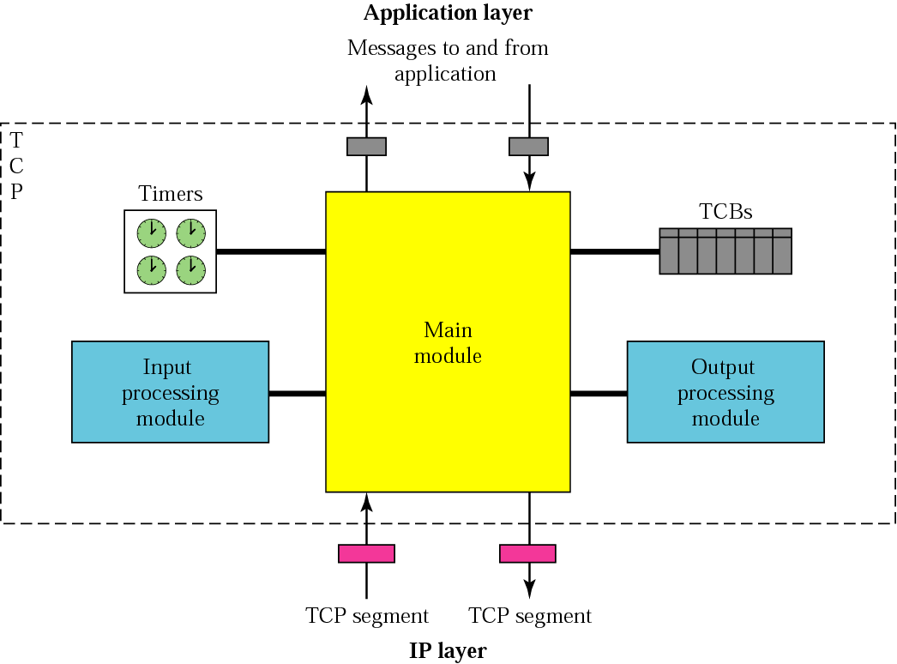
Figure TCP package
TCP/IP Protocol Suite

